Slide 1

2024 Ecuador Fire Project Fabric & Esri GeoAI Solution Type: Data Analytics & Visualization
Krishna Vamsi Regulavalasa (Team Lead)
Philippa Burgess ( Gold MLSA )
Franck Kasongo ( Gold MLSA )
Manuel Malla
Notes:
Korrie

Slide 2
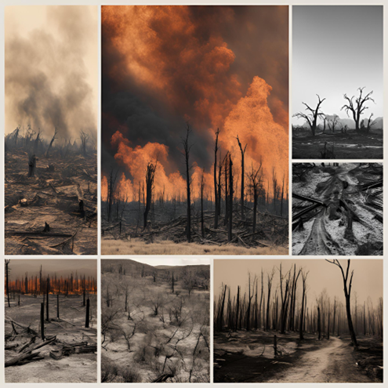
Opportunity: Pre-and-Post Fire Risk in Global Communities
🔥 Pre-Fire Risks
Climate change, deforestation, and land use changes increase wildfire frequency and intensity.
2024 Ecuador Fires burned 76,000+ hectares, destroying forests, farmland, and infrastructure.
Communities lack AI-driven risk assessment tools to prepare and mitigate damage.
🌍 Post-Fire Risks Can Be Even Greater
Landslides, erosion, and water contamination create long-term hazards after the fire is out.
Loss of forests and agricultural land disrupts ecosystems, food supply, and economic stability.
Without post-fire risk planning, communities struggle to rebuild safely and sustainably.
The challenge: How do we help communities manage wildfire risks before and after disaster strikes?
Notes:
Korrie
updated 7/21

Slide 3
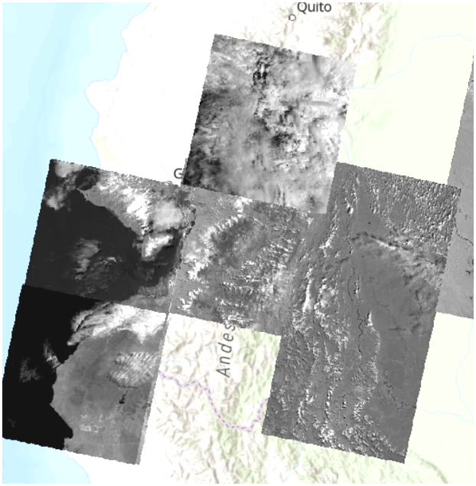
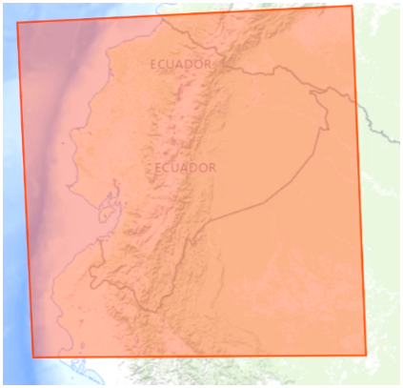
Opportunity: Pre-and-Post Fire Risk in Global Communities
🔥 Statement
The fires in the Congo Basin in 2024 were very devastating, endangering residential areas and surrounding mountains.
This situation once again exposes the vulnerability and importance of forests in general.
This same forest provides vital resources to local and surrounding populations.“
- FRANCK KASONGO
( Gold MLSA )
Notes:
Korrie
updated 7/21

Slide 4
Solution: AI + GIS in a Box for Community-Driven Wildfire Risk & Resilience
🌍 Before the Fire: Predict & Prepare
AI-driven risk mapping identifies high-risk wildfire zones.
GIS-powered community hardening strategies protect forests, farmland & infrastructure.
🔥 After the Fire: Assess & Rebuild Safely
AI + GIS detect landslides, erosion & water contamination risks.
Data-driven recovery plans support agriculture, ecosystems & economic stability.
📌 Case Study: Ecuador Wildfires 2024
Analyzing 76,000+ hectares of burned land to assess forest loss & agricultural impact.
Identifying communities at risk of post-fire flooding & landslides due to erosion.
Using AI + GIS to map recovery priorities for reforestation & infrastructure rebuilding.
Scalable, accessible, and built for global communities facing climate-driven wildfire risks.
Notes:
Korrie
updated 7/21

Slide 5
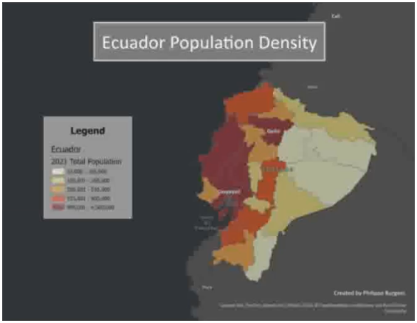
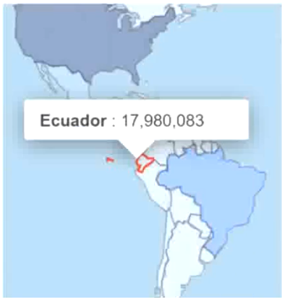
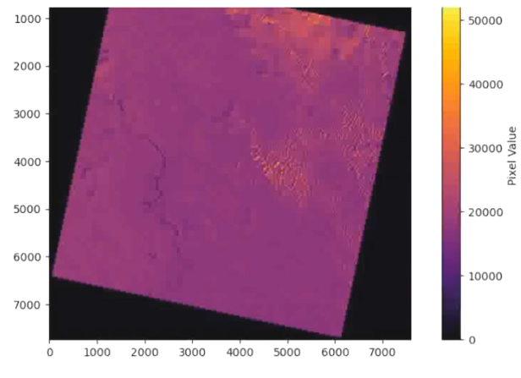
Flowchart - Workflow & Implementation
Data Collection
Landsat images, climate & historical fire data.
Preprocessing
Microsoft Fabric for cleaning & structuring
Analysis & Insights
Power BI for visualization
Actionable Reports
Governments & NGOs for decision-making.
Risk Mapping
Notes:
Korrie
updated 7/21

Slide 6



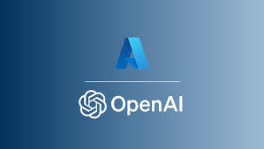
Technologies Utilized
📍 Microsoft Fabric for Data Processing & Analysis
Loads & unzips Landsat geospatial data for GIS analysis.
Processes, analyzes & visualizes structured tabular data, including demographics, economics & climate indexes.
📍 Esri ArcGIS Pro for Geospatial Insights
Maps fire risk zones & post-fire impacts using NBR & NDVI satellite imagery.
📍 AI + GIS for Wildfire Resilience
Identifies risk zones & humanitarian impacts for pre-fire mitigation & post-fire recovery.
Dashboards help governments & humanitarian organizations prioritize response strategies.
📌 Future potential: An AI chatbot using Azure OpenAI & Power Virtual Agents could enhance adoption and accessibility for global communities.
Notes:
Korrie
updated 7/21

Slide 7
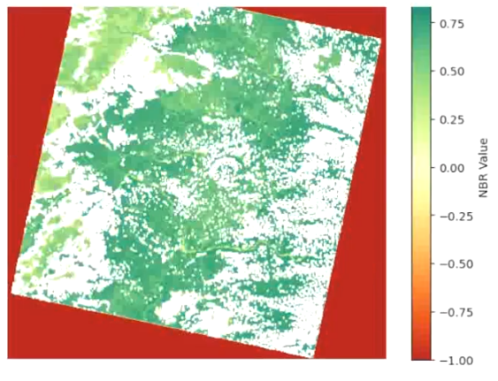
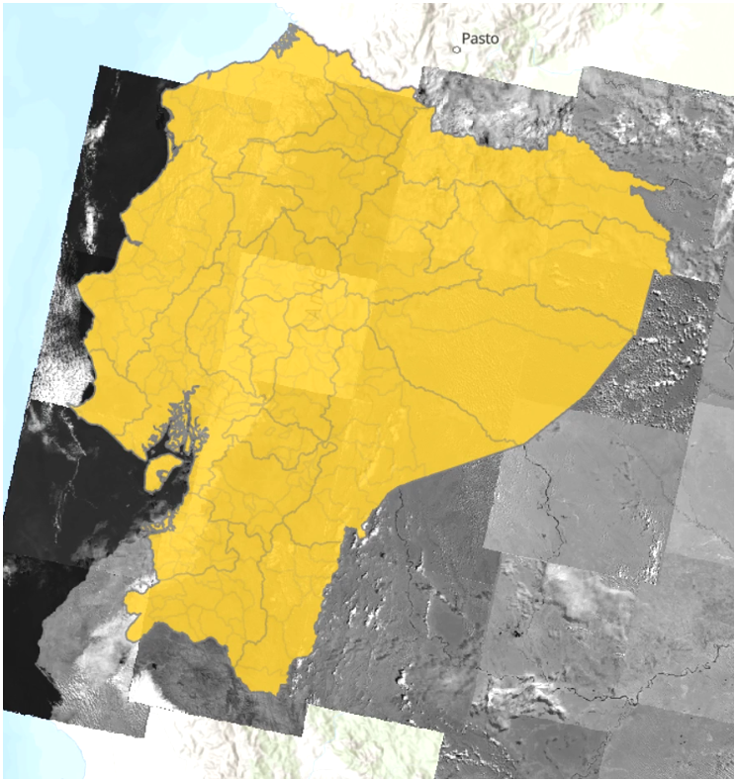
Key Achievements
📍 Analyzed 76,000+ hectares of burned land.
📍 Identified communities at risk of flooding & erosion.
📍 Expanded AI + GIS applications for disaster resilience.
📍 Applied for NASA Lifelines grant (highly rated but not awarded).
📍 Gained expertise in Microsoft Fabric & Esri ArcGIS Pro.
📌 Developed scalable, accessible solutions for wildfire-prone regions.
Notes:
Korrie
updated 7/21

Slide 8

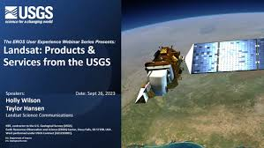

Takeaways: Team, Certifications & Strategic Partnerships
📍 Team Collaboration & Certification
Includes prior winning MSLA AI Project members.
Krishna & Philippa received DP-600 vouchers and completed Microsoft Certified: Fabric Analytics Engineer Associate studies.
📍 Mentorship & Partnerships
Advised by Philippa’s USGS EROS Center – Wildland Fire Support Geospatial Analyst internship mentors.
Manuel & Philippa coordinated a USC & UTM partnership to expand research, engage local governments & NGOs, and pursue funding opportunities.
Applied for NASA Lifelines (67 applicants – 12 accepted, not awarded but received high compliments on application) & another grant (pending).
📍 Expanding AI + GIS Capabilities
Team gained experience in Microsoft Fabric & Esri ArcGIS Pro for fire mapping & risk assessment.
Expanded our application of GeoAI beyond Azure ML Studio into Microsoft Fabric and Esri’s ArcGIS Pro for data processing, storage, analysis, visualization & insight.
Notes:
Korrie
updated 7/21

